Slide 1
Ridge, Lasso, and Elastic Net Regression
R Ladies – Boulder
Marta Jankowska
Code courtesy of Ahlam Abuawad and the Environmental Mixtures Workshop at Columbia, data courtesy of Dr. Ami Zota

Slide 2
Multivariate Regression
Regression model with several variables
Trying to reduce the residual sum of squares
Sometimes we need to reduce variables in the model
p>n
Maybe want to identify the most important variables in the model
Maybe want to remove unimportant variables from the model

Slide 3
Why not subset/forward/backward selection?
R^2 values are biased high
The F statistics do not have the claimed distribution.
The standard errors of the parameter estimates are too small.
Consequently, the confidence intervals around the parameter estimates are too narrow.
p-values are too low, due to multiple comparisons, and are difficult to correct.
Parameter estimates are biased away from 0.
Collinearity problems are exacerbated.
https://towardsdatascience.com/stopping-stepwise-why-stepwise-selection-is-bad-and-what-you-should-use-instead-90818b3f52df

Slide 4
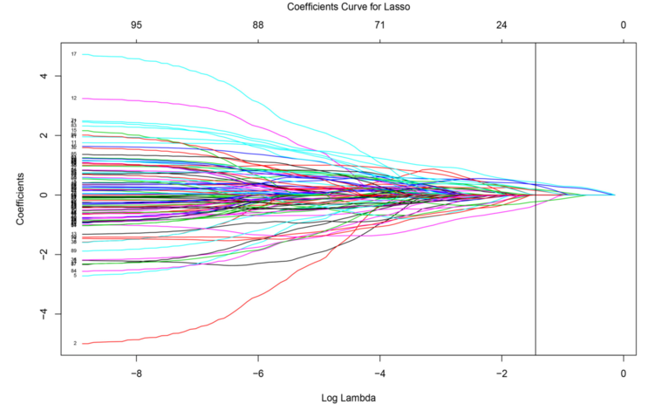
Penalized Regression
Trade some bias for lower variance and overall MSE
Can outperform OLS in some important ways
Rather than a subset selection approach, all parameters stay in the model but we restrict their effect
Penalize the size of the coefficients – “unimportant” variables will have their coefficients shrunk towards to zero

Slide 5

Ridge Lasso Elastic Net
All three methods are adding a penalty to the RSS
Ridge Formula: Sum of Error + Sum of the squares of coefficients
L = ∑( Ŷi– Yi)² + λ∑ β²
Lasso Formula: Lasso = Sum of Error + Sum of the absolute value of coefficients
L = ∑( Ŷi– Yi)² + λ∑ |β|
Elastic Net Formula: Ridge + Lasso
L = ∑( Ŷi– Yi)² + λ∑ β² + λ∑ |β|
In all three methods you are going to need to choose a λ aka the tuning function.

Slide 6


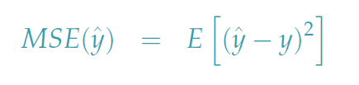
Tuning Parameters
Trying to trade increase in bias for a decrease in variance of
Mean Square Error (MSE) formalizes this, but can’t do it for in practice
Easier to perform for predictors and incorporates dependence on through the fitted values
CROSS VALIDATION

Slide 7
Differences
Ridge will reduce the impact of features that are not important in predicting your y values.
Results in coefficients that are small, but not zero
Has a closed form solution
Lasso will eliminate many features and reduce overfitting in your linear model.
Will reduce coefficients down to zero
Useful as an automated variable selection method
Use for inference, NOT prediction
When predictors are correlated, it will choose one (randomly)
Elastic Net combines feature elimination from Lasso and feature coefficient reduction from the Ridge model to improve your model’s predictions.
Combines regularization via the ridge-type penalty with variable selection via the lasso penalty
More effective to deal with groups of correlated predictors

Slide 8
Standardize Predictors
OLS estimates are scale equivariant: multiplying a predictor by a constant rescales the coefficient but leaves the model (and the fitted values) unchanged
In contrast, ridge regression coefficient estimates can change substantially when multiplying a given predictor by a constant
Rescaling a predictor changes the impact in of the coefficient in the penalty
Therefore, it is best to apply ridge regression (and other penalized methods) after standardizing the predictors

Slide 9
Describing results…
Cross validation was used to choose the tuning parameter with the lowest prediction error
The selected variables that resulted in the best predictions were [blank], and these may reflect the impact of [blank] on the response.
We compared the lasso fit to an unconstrained MLR in terms of cross-validated prediction error, and found that the lasso model resulted in ZZ% improvement in mean squared prediction error

